Slide 1
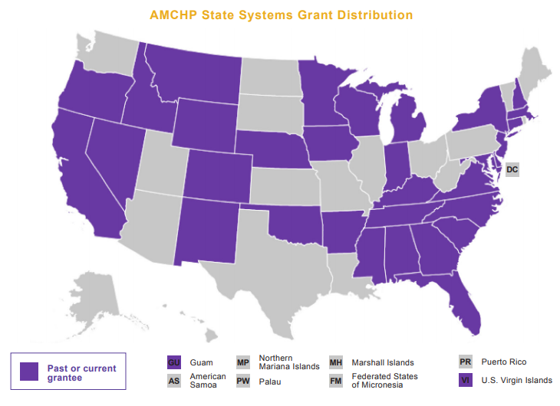
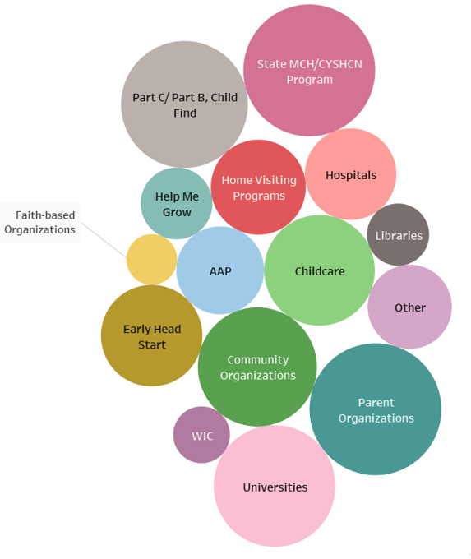
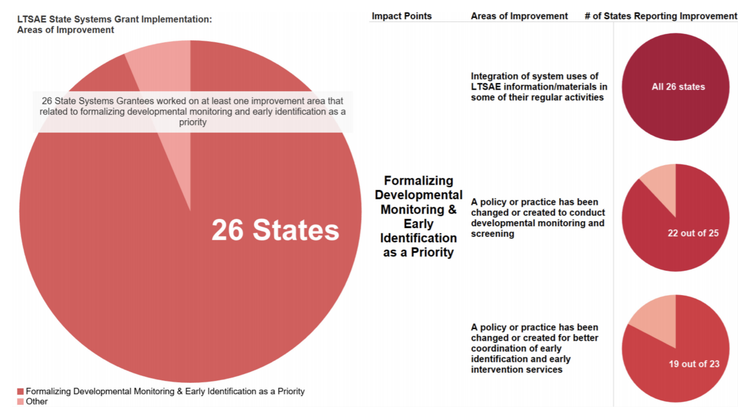
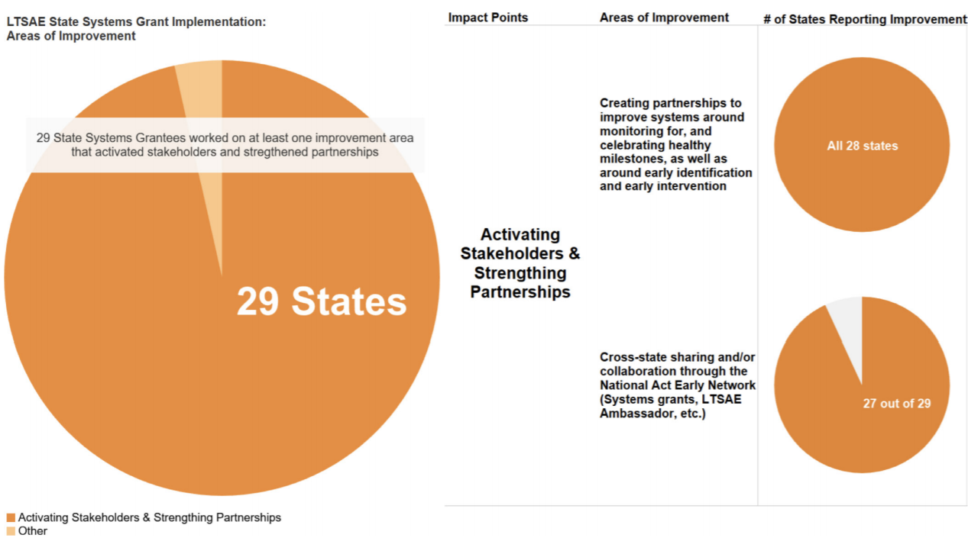
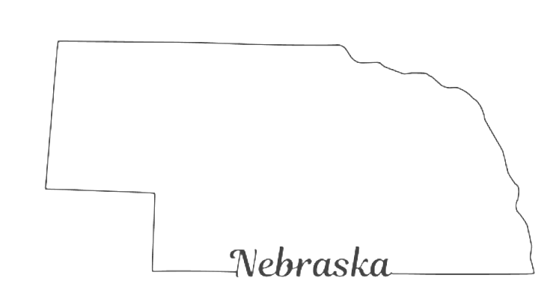
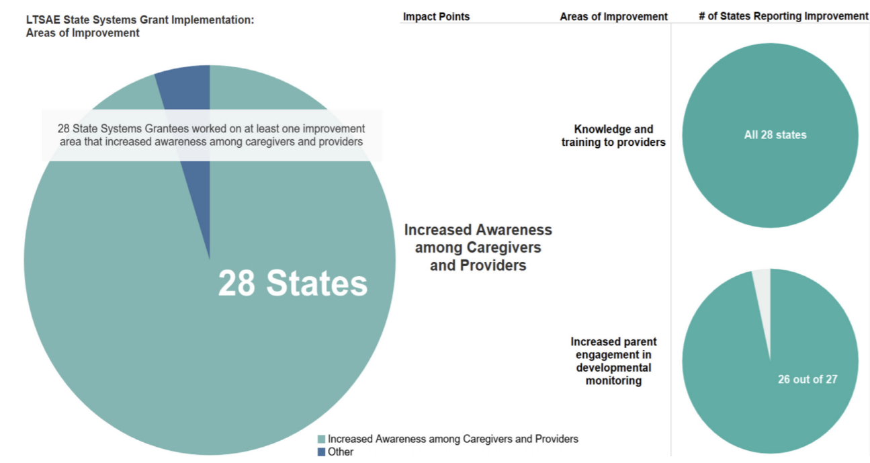
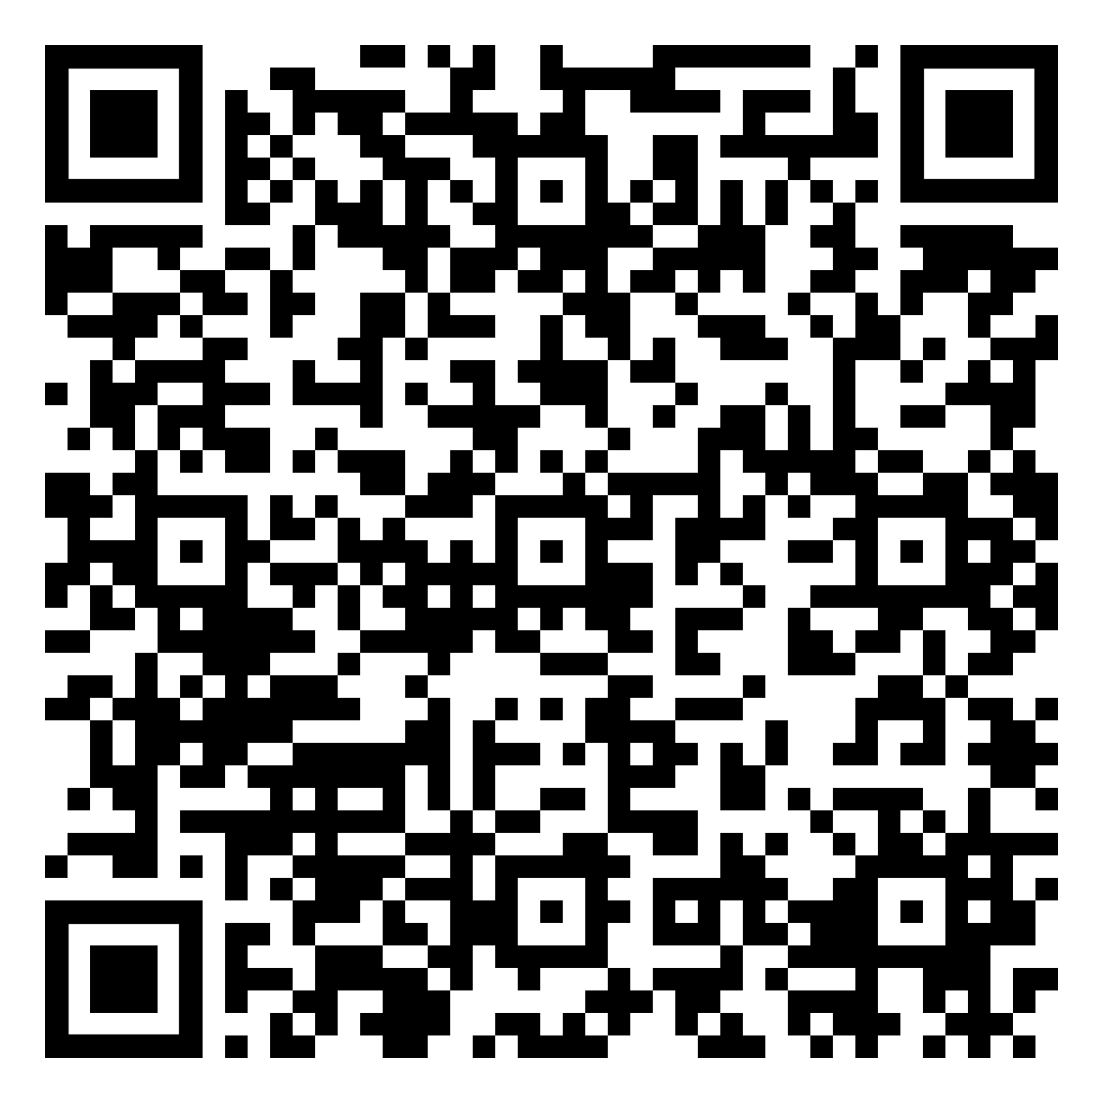
Learn the Signs. Act Early. AMCHP’s State Systems Grant: Eight Years (2011 - 2018) in Review Paige Bussanich, MS, Anna Corona, MPH, Maura Leahy, MPH, Kate Taft, MPH, and Shanel Tage, MPH, Association of Maternal & Child Health Programs
Background
Results: Impact Points
Partner Organizations
Developed a state autism plan, convened a statewide Act Early team, and institutionalized the Act Early efforts into the state early childhood system.
As part of the CDC’s Act Early Initiative, the Act Early Network was created in 2007 and convened Act Early Regional Summits throughout the U.S. from 2008‒2010; during this period, states coordinated plans regarding capacity building to identify ongoing needs of children with autism spectrum disorder and other developmental disabilities (ASD/DD). In 2010, the Association of Maternal & Child Health Programs (AMCHP) began the Learn the Signs. Act Early. (LTSAE) state systems grants in order to complement state activities initiated during the Act Early Summits. The goal of the state systems grant is to strengthen state and community systems for early identification and coordination of services for children with developmental disabilities. In addition to funding grants, AMCHP has provided quarterly technical assistance calls, connected grantees to other states and experts, and supported an interactive grantee listserv. Through support from the CDC and in partnership with the Association of University Centers on Disabilities (AUCD), LTSAE state system grants have been dispersed among 34 U.S. states and jurisdictions, with 14 participating in more than one cohort.
Increased state legislators’ awareness on issues related to ASD services and needs.
Conclusion
The survey and environmental scan revealed a wealth of information on outcomes, impact, and lessons learned from the entire eight years of the LTSAE State Systems grant program. Overall, the grant program was successful in building the capacity of states and jurisdictions to strengthen state and community systems to provide early identification and coordinate services for children with ASD/DD. Although approaches may differ across states and organizational structures, they can be adapted and replicated to aid state systems in increasing developmental monitoring and screening and improving approaches to meet the service needs for children with ASD/DD and their families.
Methods
AMCHP conducted an environmental scan of each grantee’s applications, mid-year reports, final reports, and quarterly call summaries. Following the environmental scan, AMCHP administered a survey to grant leads in April 2018 to assess each grant’s impact and outcomes, sustainability efforts and concerns, and comments not otherwise captured in the environmental scan. Grant leads from 31 states and jurisdictions responded, representing 91 percent of the grantees over the life cycle of the program. The environmental scan findings and survey results were analyzed for common themes.
1, 2, 3, Grow! YouTube and Cable TV Series
Developed and broadcasted a program about early childhood development for families of young children in eight languages on cable television stations across the state and on YouTube.
Learn more at:
bit.ly/LTSAE19
This project is supported by the Centers for Disease Control and Prevention (CDC) of the U.S. Department of Health and Human Services (HHS) under grant number U38OT000140, Office for State, Tribal, Local, and Territorial Supports (OSTLTS) Partnerships-Capacity Building Assistance (CBA) of the Public Health System ($650,485) through the Association of University Centers on Disability (AUCD). This information, content, and conclusions are those of the author and should not be construed as the official position or policy of, nor should any endorsements be inferred by CDC, HHS, or the U.S. Government

